Slide 1
Fuzzy C-mean Clustering

Slide 2
Hard Clustering vs Soft Clustering
Hard clustering is method to grouping the data items such that each item is only assigned to one cluster, K-Means is one of them. Kmean Kmediod
While Soft clustering is method to grouping the data items such that an item can exist in multiple clusters, Fuzzy C-Means (FCM) is an example.

Slide 3
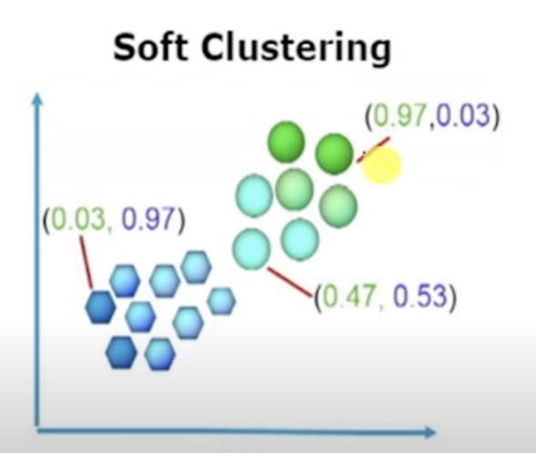
Soft Clustering – Member ship Value – Fuzzy Cmean

Slide 4
Fuzzy C-Mean – Steps
Step 1 Given the data points based on the number of clusters requied initailise the membership tabel with random values
Cluster | (1,3)`` | (2,5) | (4,8) | (7,9)
1 | 0.8 | 0.7 | 0.2 | 0.1
2 | 0.2 | 0.3 | 0.8` | 0.9

Slide 5
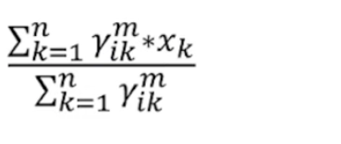
Fuzzy C-Mean – Steps
Step 1 Given the data points based on the number of clusters requied initailise the membership tabel with random values
Cluster | (1,3)`` | (2,5) | (4,8) | (7,9)
1 | 0.8 | 0.7 | 0.2 | 0.1
2 | 0.2 | 0.3 | 0.8` | 0.9

Slide 6
Fuzzy C-Mean – Steps
Step 2 Find the centroid. The formula for finding out the ventroid (V) is:
m: Fuzziness parameter generally takes as 2
x_{k:} the data point
𝜸: fuzziness membership value
V11 = (0.8² x 1 + 0.7² x 2 + 0.2² x 4 + 0.1² x 7)
------------------------------------------------------------------------------
(0.8² + 0.7² + 0.2² + 0.1² )
= 1.568
Notes:
he fuzziness parameter, denoted by m, controls how much overlap there is between clusters. It determines how the membership degrees are calculated for each data point and cluster.
n = data point

Slide 7
Fuzzy C-Mean – Steps
Step 2 Find the centroid. The formula for finding out the centroid (V) is:
m: Fuzziness parameter generally takes as 2
x_{k:} the data point
𝜸: fuzziness membership value
V12 = (0.8² x 3 + 0.7² x 5 + 0.2² x 8 + 0.1² x 9)
------------------------------------------------------------------------------
(0.8² + 0.7² + 0.2² + 0.1² )
= 4.051

Slide 8
Fuzzy C-Mean – Steps
V21 = (0.2² x 1 + 0.3² x 2 + 0.8² x 4 + 0.9² x 7)
------------------------------------------------------------------------------
(0.2² + 0.3² + 0.8² + 0.9² )
= 5.35
V21 = (0.2² x 3 + 0.3² x 5 + 0.8² x 8 + 0.9² x )
------------------------------------------------------------------------------
(0.2² + 0.3² + 0.8² + 0.9² )
=8.215

Slide 9
Fuzzy C-Mean – Steps
Step 3 Find out the distance of each point from the centroid use any distance measure. Centroid are (1.568,4.051) and (5.35, 8.215)
Data Points | Cluster 1 | Cluster 2
D1 | 1.2 | 6.79
D2
D3
D4
Cluster | (1,3) | (2,5) | (4,8) | (7,9)
1 | 0.8 | 0.7 | 0.2 | 0.1
2 | 0.2 | 0.3 | 0.8` | 0.9

Slide 10
Fuzzy C-Mean – Steps
Step 3 Find out the distance of each point from the centroid use any distance measure. Centroid are (1.568,4.051) and (5.35, 8.215)
Data Points | Cluster 1 | Cluster 2
D1 | 1.2 | 6.79
D2 | 1.04 | 4.64
D3 | 4.63 | 1.36
D4 | 7.34 | 1.82
Cluster | (1,3) | (2,5) | (4,8) | (7,9)
1 | 0.8 | 0.7 | 0.2 | 0.1
2 | 0.2 | 0.3 | 0.8` | 0.9
 | C1 | C1 | C2 | C2

Slide 11
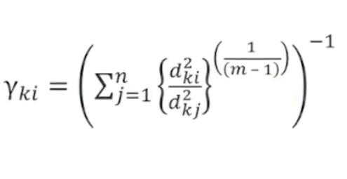
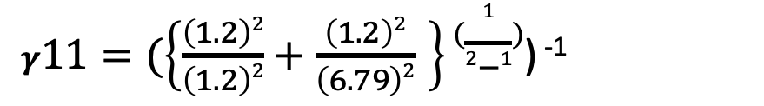
Fuzzy C-Mean – Steps
Cluster | (1,3) | (2,5) | (4,8) | (7,9)
1 | 0.8 | 0.7 | 0.2 | 0.1
2 | 0.2 | 0.3 | 0.8` | 0.9
 | C1 | C1 | C2 | C2
Step 4 Update Member ship Table
= 0.97
Data Points | Cluster 1 | Cluster 2
D1 | 1.2 | 6.79
D2 | 1.04 | 4.64
D3 | 4.63 | 1.36
D4 | 7.34 | 1.82
𝜸$11=(\left\{\frac{\left(1.2\right)2}{\left(1.2\right)2}+\frac{\left(1.2\right)2}{\left(6.79\right)2} \right\}(\frac{1}{2−1})$) ⁻¹

Slide 12
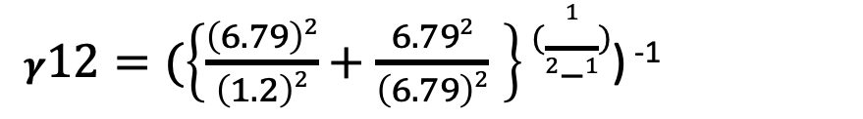
Fuzzy C-Mean – Steps
Cluster | (1,3) | (2,5) | (4,8) | (7,9)
1 | 0.8 | 0.7 | 0.2 | 0.1
2 | 0.2 | 0.3 | 0.8` | 0.9
 | C1 | C1 | C2 | C2
Step 4 Update Member ship Table
= 0.03
Data Points | Cluster 1 | Cluster 2
D1 | 1.2 | 6.79
D2 | 1.04 | 4.64
D3 | 4.63 | 1.36
D4 | 7.34 | 1.82
𝜸$12=(\left\{\frac{\left(6.79\right)2}{\left(1.2\right)2}+\frac{6.792}{\left(6.79\right)2} \right\}(\frac{1}{2−1})$) ⁻¹

Slide 13
Fuzzy C-Mean – Steps
Cluster | (1,3) | (2,5) | (4,8) | (7,9)
1 | 0.8 | 0.7 | 0.2 | 0.1
2 | 0.2 | 0.3 | 0.8` | 0.9
 | C1 | C1 | C2 | C2
Step 4 New Member ship Table
Data Points | Cluster 1 | Cluster 2
D1 | 1.2 | 6.79
D2 | 1.04 | 4.64
D3 | 4.63 | 1.36
D4 | 7.34 | 1.82
Cluster | (1,3) | (2,5) | (4,8) | (7,9)
1 | 0.97 | 0.95 | 0.08 | 0.06
2 | 0.3 | 0.05 | 0.92 | 0.94

Slide 14
Fuzzy C-Mean – Steps
Step 5 Repeat steps 2-4 until the constant values are obtained for the membership values or the differnece is less than the tolerance (<=0.1)
Cluster | (1,3) | (2,5) | (4,8) | (7,9)
1 | 0.8 | 0.7 | 0.2 | 0.1
2 | 0.2 | 0.3 | 0.8` | 0.9
Cluster | (1,3) | (2,5) | (4,8) | (7,9)
1 | 0.97 | 0.95 | 0.08 | 0.06
2 | 0.3 | 0.05 | 0.92 | 0.94

